Slide 1
Introduction to Handwriting
This presentation will help staff:
Recognise skills needed for handwriting
Identify common difficulties

Slide 2
Skills for Handwriting
Handwriting is a complex task requiring strength, coordination, skill and ability.
Young people need a range of complex skills for successful handwriting.

Slide 3
Skills for Handwriting
Adequate postural control (core stability) to have control of the upper limbs
The ability to control the small muscles of the hand to move the pencil in the correct directions

Slide 4
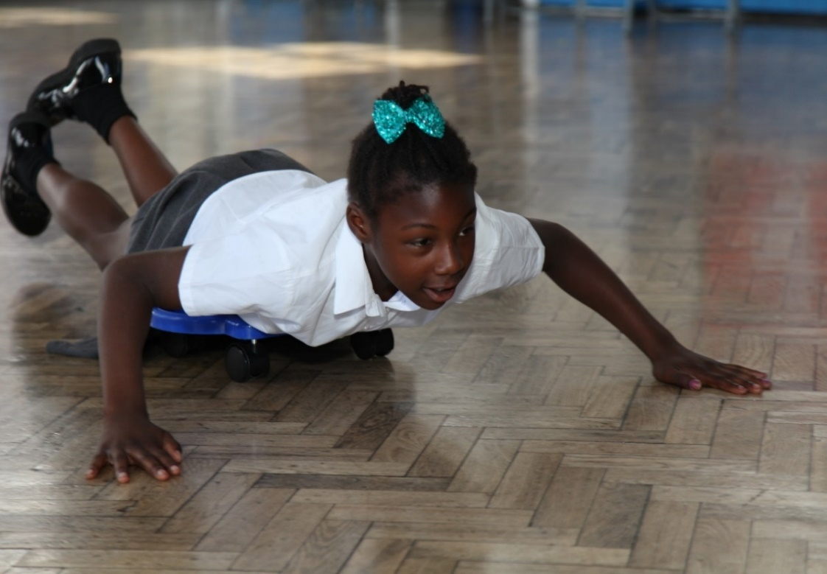
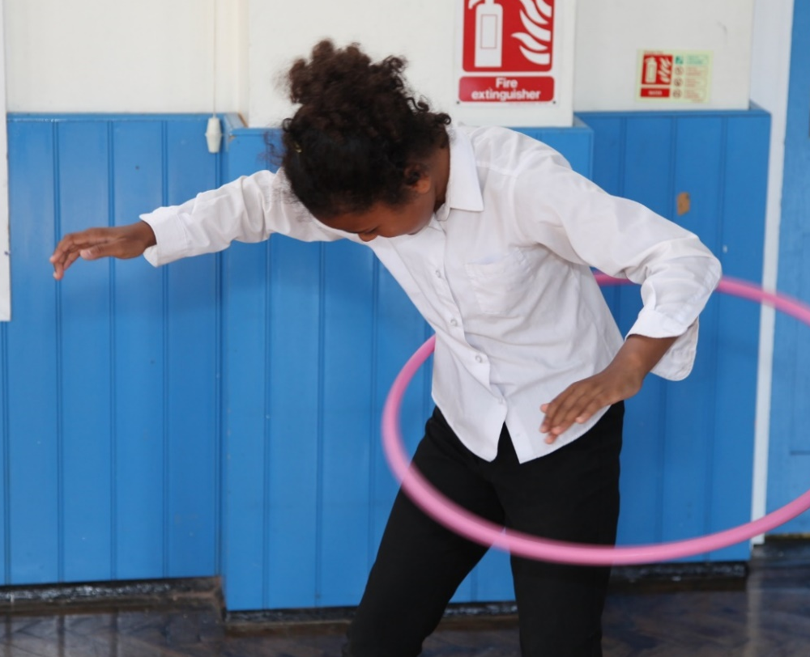
Skills for Handwriting
Body awareness (See body awareness section)
Control of force of movement

Slide 5
Skills for Handwriting
Hand/eye coordination
Hand dominance

Slide 6
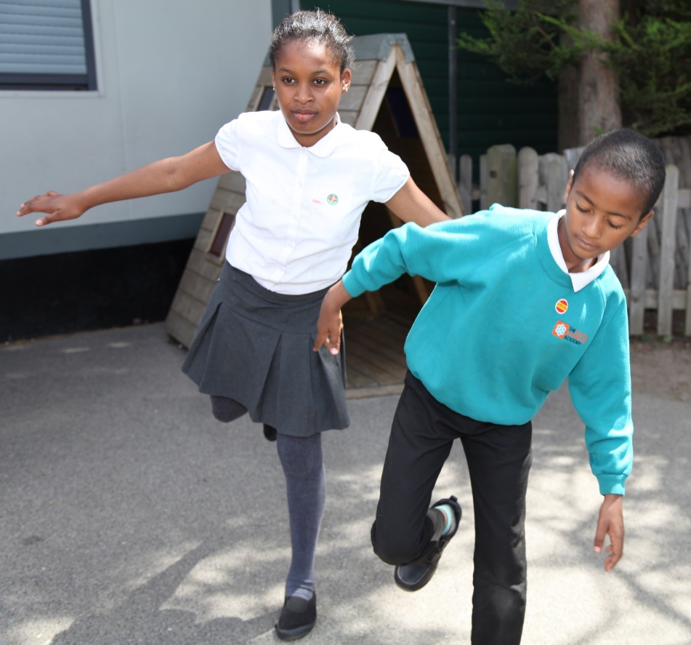
Skills for Handwriting
Perceptual skills
Motor planning ability

Slide 7
Skills for Handwriting
Visual discrimination
Recognition of shapes to form letters

Slide 8
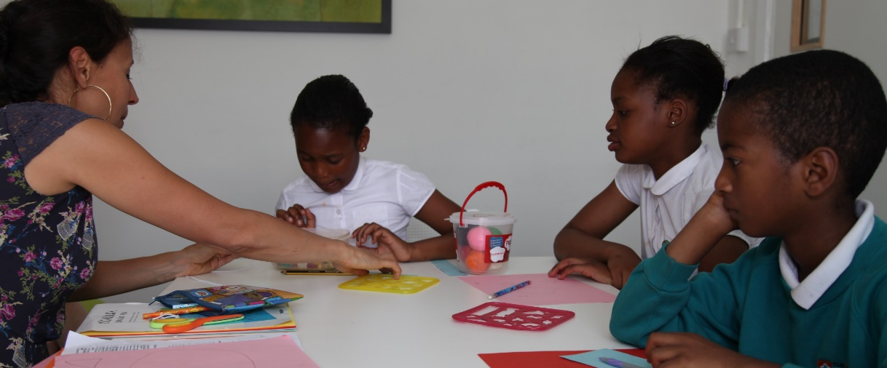
Skills for Handwriting
Attention
Language processing at a cognitive level

Slide 9
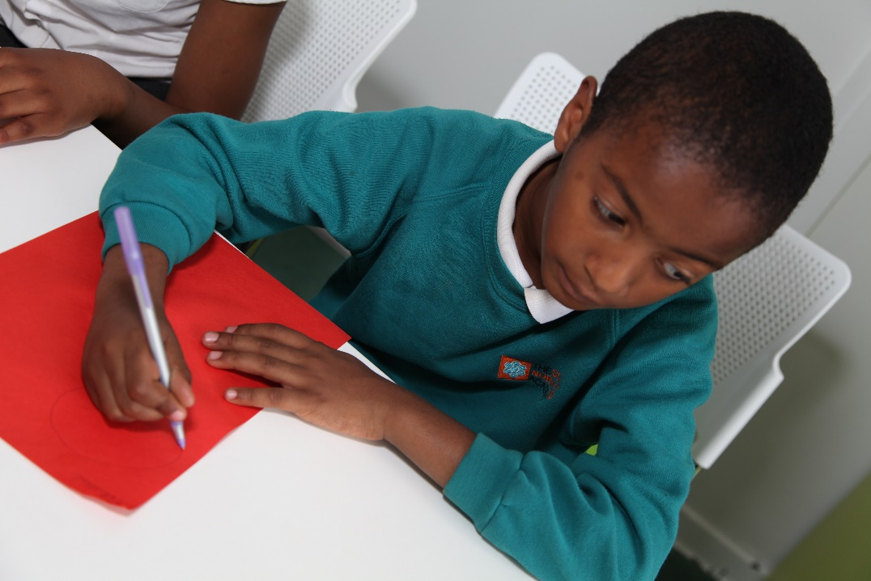
Common Difficulties
Children can have many difficulties which can impact upon their writing.
Some of these are linked to fine/gross motor skills; others are not.
All cause barriers to successful and effortless handwriting.

Slide 10
Common Difficulties
Pushing too hard or not enough with a pencil
Ineffective pencil grasp

Slide 11
Common Difficulties
Swapping hands
Hand pain

Slide 12
Common Difficulties
Producing unrecognisable shapes on paper
Reversals and repetition

Slide 13
Common Difficulties
Leaning on tables
Fidgeting

Slide 14
Common Difficulties
Slow to produce work

Slide 15
Common Difficulties
Opting out
Distractibility

